Slide 1
HEART FAILURE
MORTALITY
PREDICTION
DSI23 - Capstone
Tay Yi Li
Notes:
Predict whether a patient dies from heart failure, more details on this later

Slide 2
CONTENTS
1
2
3
4
Background
EDA
Overview
Problem Statement
Objectives
Overview
Feature Selection
Modelling
Conclusion
Metrics
Evaluation
Model Uses
Recommendations
Notes:
We will go through background - overview, problem statement, objectives

Slide 3
1
Background

Slide 4
Overview: Heart Failure
Heart muscle does not pump blood well
No cure
Cardiovascular diseases (CVDs) frequently ends in Heart Failure
Notes:
- heart failure -- occurs when the heart is no longer able to pump as well as it should and patient does not get enough oxygen
- no cure and can be fatal
- some research revealed that cardiovascular diseases frequently ends in heart failure
- can also say that CVDs are one of the most common causes of heart failure
Why did i specifically bring up CVDs? That is cause..

Slide 5
17,900,000
Deaths by CVDs in 2019
Notes:
CVDs have consistently been a leading cause of death -- 17.9 million deaths by CVD in 2019
Put in percentage..

Slide 6

32%
CVDs accounted for 32% of all deaths in 2019
Notes:
It means that in 2019, 32% of all deaths recorded globally was caused by CVDs
- and remember we mentioned that CVDs frequently ends in Heart Failure

Slide 7
CVDs can be prevented/controlled if we..
Address Behavioural Risk Factors
Unhealthy diet
Lack of exercise
Smoking, etc..
Manage Underlying Conditions
High Blood Pressure
Diabetes, etc..
Notes:
- good thing is that most CVDs can be prevented by addressing risk factors like unhealthy diet, lack of exercise, smoking
- CVDs can also be controlled if we manage existing underlying conditions like high blood pressure or diabetes

Slide 8
Since Heart Failure is commonly caused by CVDs
Controlling and Managing
CVDs’
Risk Factors to prevent deaths
Controls and prevents
death by
Heart Failure
The key is early detection and management!
Notes:
- since we found that Heart Failure is very very commonly caused by CVDs
- by controlling and managing the risk factors of CVDs to prevent death -- we’re also controlling and preventing death by Heart Failure
- since the risk factors of CVDs are basically the risk factors leading to heart failure
the key would be early detection and management of these risk factors, by giving earlier care and attention to keep conditions under control and prevent deaths by heart failure
Which brings us to the problem statement

Slide 9
Problem Statement
With earlier care and attention given, mortality by heart failure can be prevented. The Department of Cardiology tasked the newly established Data Science Department to find a way to identify patients with high risks of mortality by Heart Failure through use of data science to enable them to provide necessary preventive care and attention for the patients early.
To achieve this, the project aims to build a classifier which uses patients’ health conditions to accurately predict mortality by Heart Failure.
Notes:
With earlier care and attention, we can prevent mortality by heart failure. Newly established Department of Data Science has been tasked by the Department of Cardiology to find a way to identify patients at high risk of mortality by Heart Failure through use of data science to enable the Department of Cardiology to provide necessary preventive care and attention earlier
This project aims to build a classifier using the patients’ health conditions, which are the same risk factors we discussed earlier, to accurately predict mortality by Heart Failure -- in this classifier, the patients who are predicted to succumb to/die from Heart Failure are the patients who are identified to have high risk of mortality by Heart Failure

Slide 10

Objectives
Build a classifier using patients’ health conditions to accurately predict mortality by Heart Failure.
Model will help identify patients most in need of earlier care and attention.
Metrics used:
F1 score
Precision-Recall score
Train/Test Accuracy
Notes:
Objectives, as mentioned, is to build a classifier predicting mortality by Heart Failure. The resulting model will help to identify patients most in need of earlier care and attention to ensure they survive
Metrics used to compare the models are:
F1 score
Precision-Recall score with special focus on Recall score
Train Test Accuracy to check for underfitting or overfitting
Will talk more about the metrics under the model evaluation section

Slide 11
2
EDA
Notes:
Moving onto exploring the dataset and researching on the variables

Slide 12
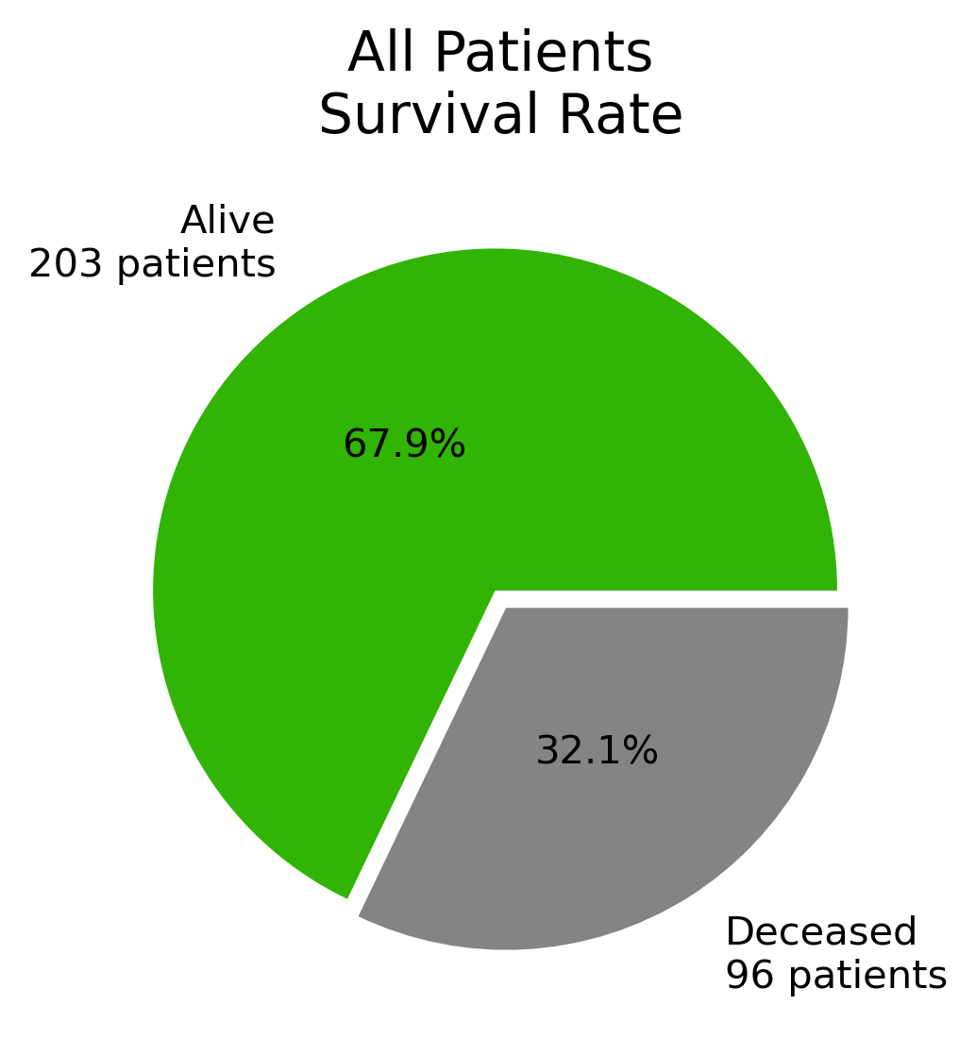
Overview - Dataset
Dataset obtained from Kaggle
13 features in total including target variable
No clean up required
Imbalanced dataset
Notes:
Overview of the entire dataset:
- obtained from Kaggle
- total of 13 features including target variable
- dataset was very clean and no cleanup was required -- no NULL values and all values were of the correct data type
- the dataset is found to be imbalanced -- 67.9% of the patients are alive while 32.1% passed away
Imbalanced dataset had a part in influencing the metrics chosen to compare and evaluate the models which we will discuss later in the models evaluation section

Slide 13
Overview - Target Variable
Target variable: death_event
death_event is binary and indicates whether the patient survived
death_event
Value in Dataset | Heart Failure Survival | Class
1 | Deceased | Positive
0 | Alive | Negative
Notes:
Our target variable is the feature called death_event
It is binary and indicates whether a patient survived or not
Value of 1 indicates that the patient passed away
Value of 0 indicates that the patient survived

Slide 14
Overview - Research
Feature Name | Description Summary | Relationship with Heart Failure
Anaemia | Lower than usual red blood cells/hemoglobin | Untreated anaemia potentially leads to heart failure
Creatine Phosphokinase (CPK-MB) | Enzyme that leaks into blood when heart is damaged | Elevated levels indicate injury to heart
Diabetes | Inability to regulate blood sugar | Increases chances of getting CVDs
Ejection Fraction (EF) | Percentage of blood pumped out of heart | Low EF indicates heart is not working well, heart failure is likely occurring
High Blood Pressure (HBP) | Blood pressure is consistently higher than normal | HBP increases risk of CVDs and heart attack
Platelets | Small blood cells that forms clots to stop bleeding | Too many platelets may result in heart attack
Serum Creatinine | Waste product filtered out of blood by kidneys | Elevated levels may be indicator of heart failure
Serum Sodium | Amount of sodium in blood | Low levels may be indicator of heart failure
Notes:
Research on the features -- i won’t go into details, only give a very brief summary and the important thing to note, which is the relationship of the feature with heart failure
I also wont go through all 13 features, only those that are less intuitive like those in the table -- other features are things like whether the patient smokes and what their gender is, which i won’t go through
The relationship with heart failure is what was found through hours of research and looking into different articles and journals so anyone here going for health checkup, might want to take note (go through the table here) KREE-A-TIN KREE-A-TUH-NIN
Basically the research into all the features inside the dataset indicates that they are independent of each other and they all have a relationship with heart failure and death_event -- we are expecting a decent value of correlation with the target variable and has an impact on our predictions, maybe above 0.5? --> we’ll see if our assumptions are true in a heatmap next

Slide 15
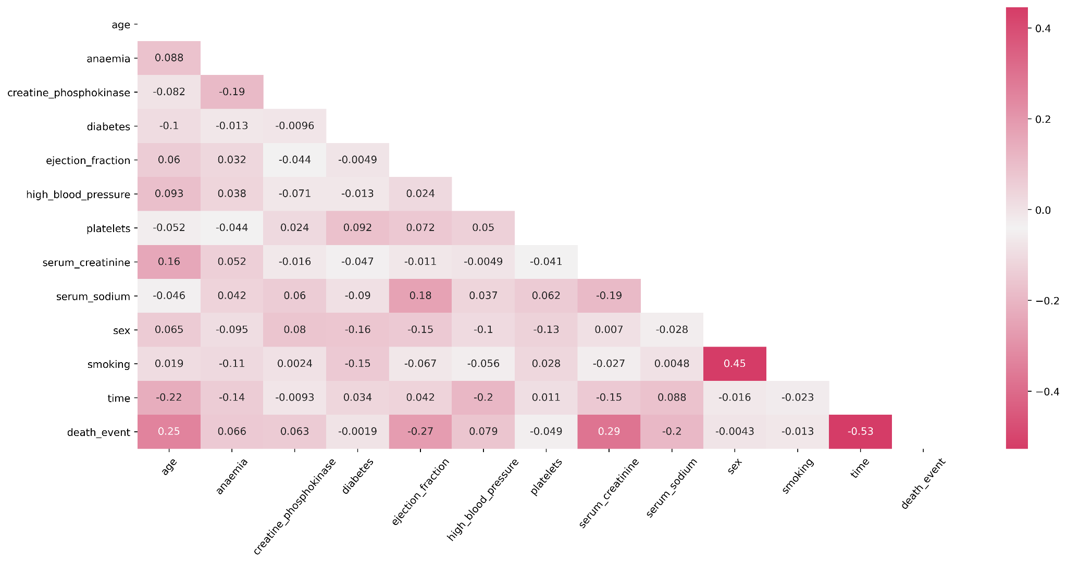
Feature Selection
Notes:
So we plotted the heatmap, and if we focus on the bottom most row, we see that most of our features actually have minimal correlation with the target variable, the death_event
Our assumptions were wrong and there is very low correlation throughout the whole dataset -- probably not a case of my model proving thousands of research papers wrong, but more likely due to the fact that our dataset is very small, only 299 patient data and is therefore insufficient to come up with definitive conclusions regarding the relationships
If i want to see a definitive relationship between the features, likely gonna need much more data, above 1000 patients at the very least -- this will be mentioned again in the conclusions

Slide 16
Feature Selection
Notes:
Working with the data that i have, features with correlation of 0.25 or higher were chosen for modelling:
Age
ejection fraction
serum creatinine (KREE-A-TUH-NIN)
time

Slide 17
3
Modelling
Notes:
Next we move onto modelling and evaluations

Slide 18
Metrics
1
F1 Score
2
Precision-Recall Score
3
Train/Test Accuracy
Notes:
As mentioned earlier, the metrics that we used to compare and evaluate the models will be in the following priority:
F1 score
Precision-Recall score with special focus on Recall score
Train Test Accuracy to check for underfitting or overfitting
I know accuracy is a very common metric used for model comparison and performance evaluation -- the reason why we do not use it here as a main metric is due to the fact that:
- our dataset is imbalance and
- we want to put special focus on the Recall score, which directly affects F1 score and is a better choice in this case

Slide 19
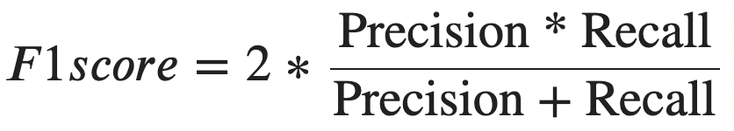
F1 Score as main evaluation metric
Indication of model’s accuracy on the dataset and overall performance
Weighted average of Precision-Recall score
Affected by Recall score
Good model = High F1 score
Notes:
- F1 score gives indication of the model’s accuracy on the dataset and the overall performance -- used to compare performance between the different classifiers we trained
- it is the weighted average of precision and recall score -- so it is affected by the recall score, something we want to pay special attention, making it a good metric for us to use for evaluation
- good model will have a high F1 score

Slide 20
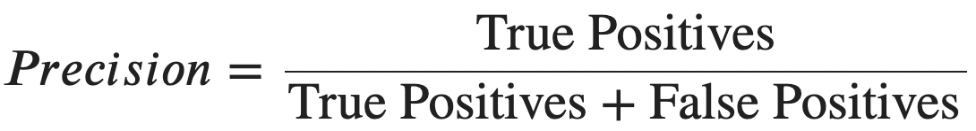

Precision-Recall Score with focus on Recall
Trade-off between Precision and Recall scores
Between False Positive and False Negative, we want to have low False Negative
False Negative = predict to survive, but passed away
False Positive = predict to pass away, but survived
False Negative patients are not identified as “high risk of mortality by Heart Failure”
Patient does not receive earlier care and attention that may save their life
False Negatives as low as possible = Recall score as high as possible
Notes:
- Usually there is a trade off between precision and recall score depending on the threshold we set and the prediction we want to prioritise
- it is best if we can have a perfect model with 100% correct predictions, but as of this point currently, that’s not possible -- so choose between False Positive and False Negative, we rather have higher False Positive in exchange for as low False Negative as possible. Why do i want this?
- FN = predict to survive, but succumbed to Heart Failure and passed away | FP = predict to succumb to Heart Failure, to pass away, but patient survived
- i want as low False Negative as possible because if the model predicts the patient to survive, they are identified as “someone who is not in the high risk of mortality by Heart Failure” when they actually are
- patient ends up not receiving earlier care and attention which may have saved their life
- So we pay attention to get as high a Recall score as possible since this means False Negatives are low

Slide 21
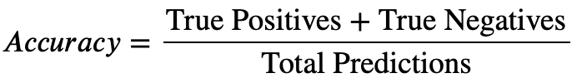
Accuracy score not used as main evaluation metric
Overview of model’s ability in predicting majority and minority class combined
Unreliable scoring for imbalanced datasets
Majority class would have high number of correct predictions, leading to high Accuracy score
Masks model’s inability to correctly classify minority class
Not really affected by Recall score
Train/Test Accuracy to be compared to check for underfitting/overfitting
Notes:
Moving to accuracy score, reason why we don’t use accuracy score as the main metrics:
- it gives an overview of the model’s ability to predict the majority AND the minority class combined together
- results in unreliable scoring when dealing with imbalanced datasets since the model would be very proficient in predicting majority class but might not be proficient in predicting minority class
- but the Accuracy score might be high anyway due to the high number of correct majority class predictions
- basically it potentially masks the model’s inability to correctly classify minority class
- also, it is not really affected by False Negatives or Recall score, things that we want to take special note of, so it is not used as the main evaluation metric
- instead, we will use train and test accuracy for comparison and see if there is underfitting or overfitting

Slide 22

Baseline Model - Logistic Regression
F1 Score of 72%
72%
Notes:
Our Baseline model is a logistic regression model with default parameters, scoring 72% on F1 score -- will use this F1 score as comparison with other tuned models to see if they beat the baseline

Slide 23
Models
1
2
3
4
Support Vector Classifier
Random Forest
AdaBoost
XGBoost

Slide 24
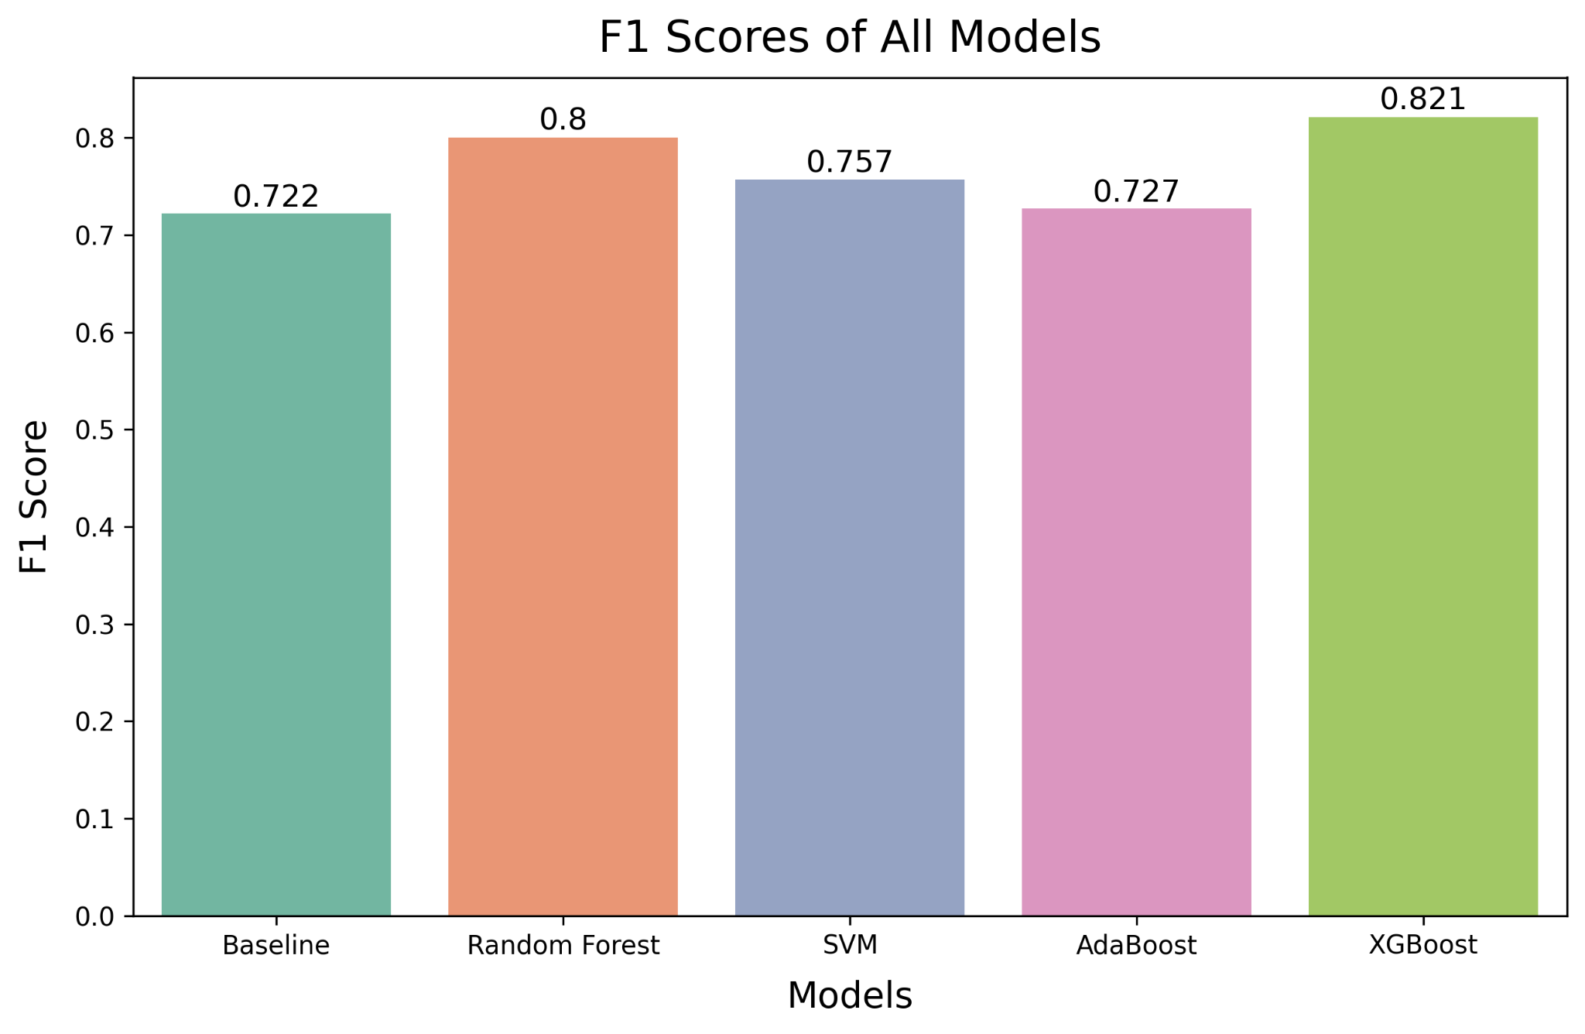
Models Comparison - F1 Score
XGBoost has highest F1 score of 0.821
Notes:
First we compare the F1 score -- All models scored higher F1 score than the baseline, so all the tuned models managed to beat the baseline
We find XGBoost has the highest F1 followed by Random Forest -- XGBoost has best overall performance, potentially the model we will choose
Next, we will check Precision and Recall score to see if it is still the best performing

Slide 25
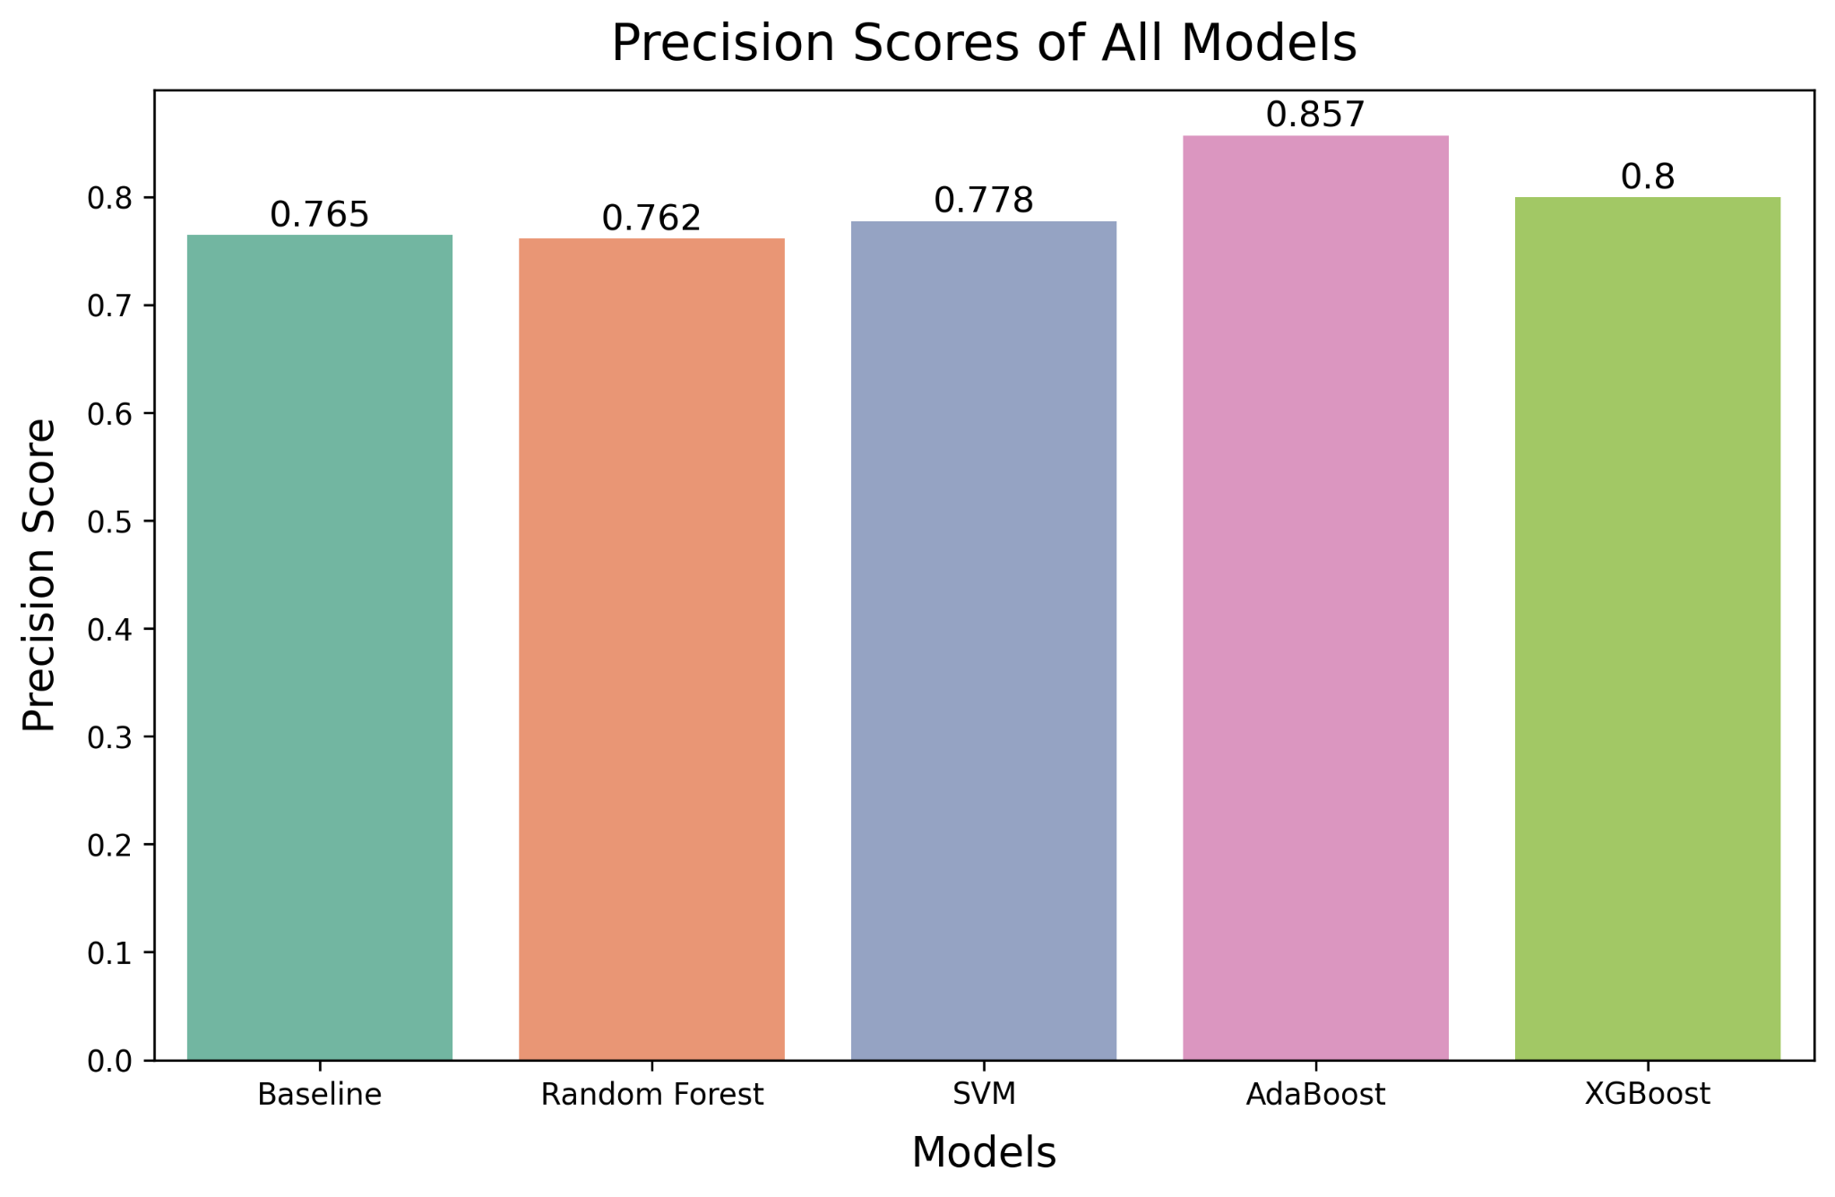
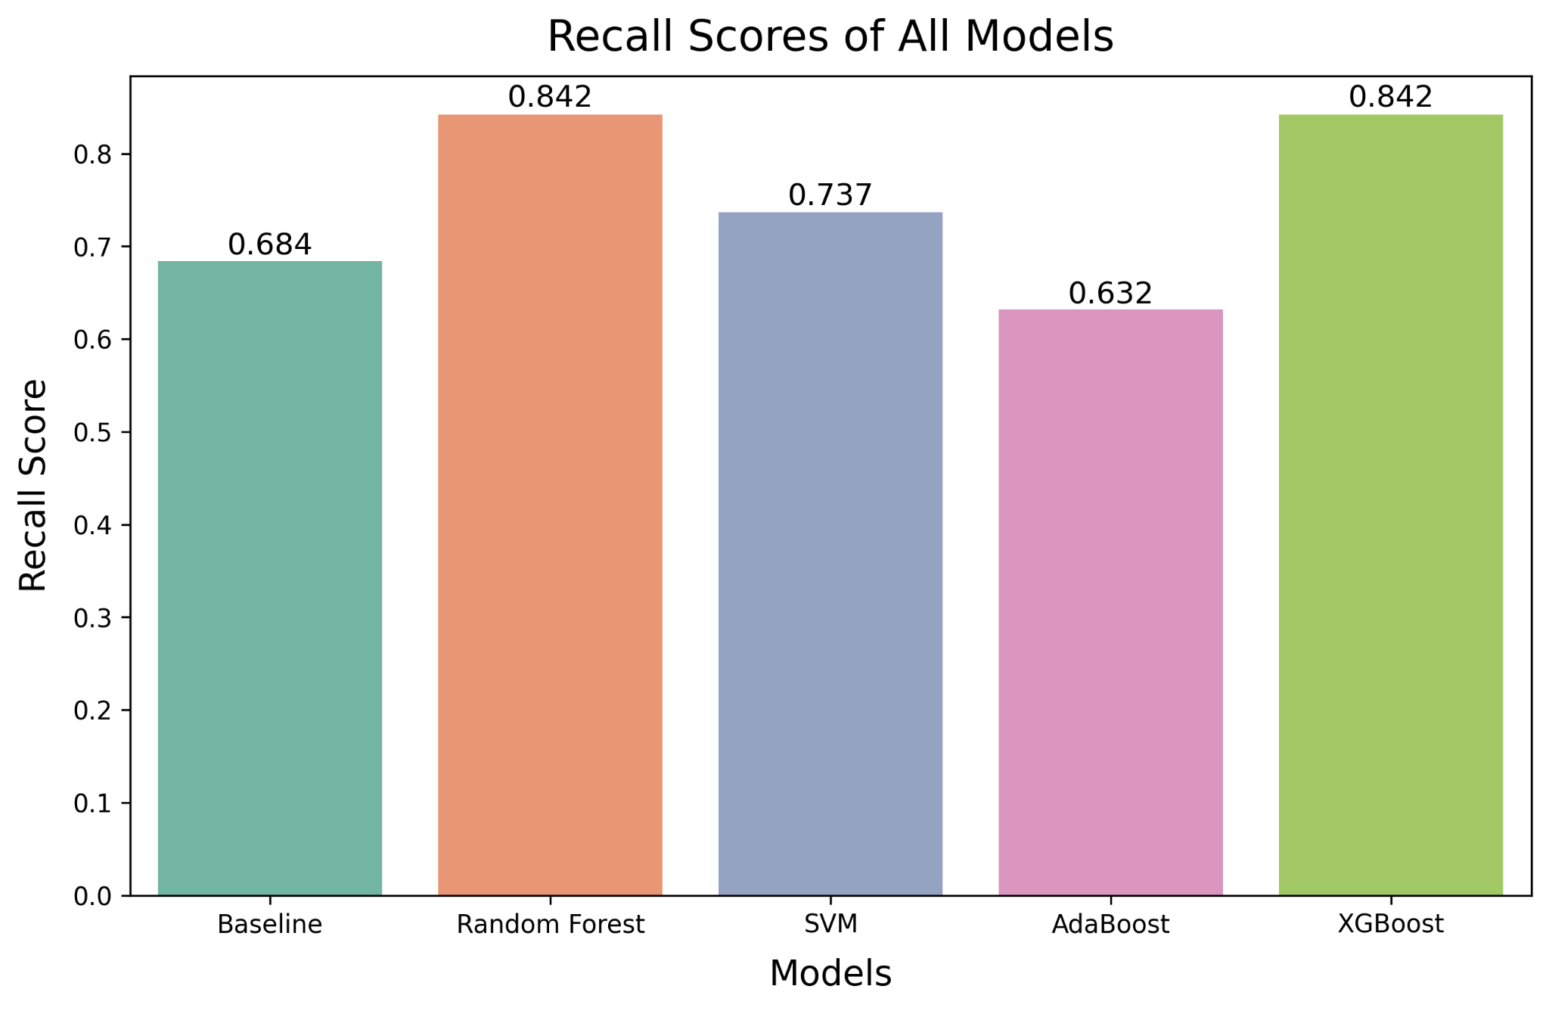
Models Comparison - Precision-Recall Score
XGBoost has highest Recall score of 0.842
Notes:
Next priority, we see XGBoost has the highest Recall score of 0.842, something we want to prioritise to prevent fatal misclassifications
Random Forest has the same Recall score, but XGBoost has higher Precision score than Random Forest
So far XGBoost seems like the best model to choose
Lastly we check Train Test Accuracy to see if there are overfitting or underfitting

Slide 26








Models Comparison - Accuracy Scores
Train
Test
Train
Test
Random Forest
SVM
Train
Test
Train
Test
AdaBoost
XGBoost
79%
78%
81%
78%
85%
73%
86%
83%
Notes:
In terms of Accuracy score, XGBoost shows very slight overfitting with Train being 3% higher than Test, but it is not as severe as other models other than Random Forest
Lets take a look at the summary of all the scores before we make a final decision

Slide 27
Models Comparison - Summary
 | F1 score | Precision | Recall | Train Accuracy | Test Accuracy
Baseline | 0.722 | 0.765 | 0.684 | 0.820 | 0.833
Random Forest | 0.800 | 0.762 | 0.842 | 0.795 | 0.783
SVM | 0.757 | 0.778 | 0.737 | 0.816 | 0.850
AdaBoost | 0.727 | 0.857 | 0.631 | 0.849 | 0.733
XGBoost | 0.821 | 0.800 | 0.842 | 0.862 | 0.833
Notes:
Comparing all the scores in here, we see XGBoost has the highest F1 score and highest Recall score, the 2 things we prioritised
Precision score is relatively high and the model is not grossly overfitted or underfitted
Therefore, the chosen model would be the XGBoost model moving forward

Slide 28
4
Conclusion
Notes:
So to wrap up

Slide 29
Problem Statement
With earlier care and attention given, mortality by heart failure can be prevented. The Department of Cardiology tasked the newly established Data Science Department to find a way to identify patients with high risks of mortality by Heart Failure through use of data science to enable them to provide necessary preventive care and attention for the patients early.
To achieve this, the project aims to build a classifier which uses patients’ health conditions to accurately predict mortality by Heart Failure.
Notes:
Recall the problem statement and objectives of this project:
aims to build a classifier using the patients’ health conditions, to accurately predict mortality by Heart Failure -- in this classifier, the patients who are predicted to succumb to/die from Heart Failure are the patients who are identified to have high risk of mortality by Heart Failure
This identification will allow the doctors to provide necessary preventive care and attention earlier for each patient and therefore prevent mortality by heart failure

Slide 30
Conclusion - Model Uses
Best Performing: XGBoost model
F1 score of 0.821
Recall score of 0.842
Model may help with:
Faster identification of patients at highest risk of mortality from heart failure
Allow more efficient allocation of appropriate attention and resources to patients who needs it most
Notes:
We found the best performing model to be the XGBoost, scoring 0.821 for F1 score and 0.842 for Recall score, the 2 metrics we prioritise
What this classification model is able to do is help with faster identification of patients at highest risk of mortality from heart failure
This can also help allow for more efficient allocation of appropriate attention and resources to patients who needs it most

Slide 31
Conclusion - Recommendations
Recommendations for further improvement
Tuning hyperparameters
More rows of data
More specific details on underlying conditions
Future Steps
Modify model to generate likelihood of mortality from heart failure
Apply model to other types of causes of death, like stroke
Notes:
further improvement would be required since this model deals with mortality, so misclassification may have severe consequences
Recommendations for further improvement includes finetuning the hyperparameters
We also need more rows of data to improve performance and get more reliable results
We can also get more details and split each feature further to try to understand if different forms of each specific medical condition has varying effect on the patient’s survivability -- for example diabetes type 1 or diabetes type 2
Future steps include modifying the model so we can get the actual likelihood of mortality from heart failure instead of binary classification, and also apply the model to other types of causes of death, like stroke

Slide 32
THANKS!
Any questions?

